Slide 1

Unit-I
Basic computer Organization
D.Venkata Vara Prasad
Professor
Dept. of Computer Science & Engg.
SSNCE

Slide 2
Objectivies
What is CA?
Why CA ?
The Big Picture
Performance

Slide 3
CA…
What is a computer?
A Computer is a machine which solves problems for people written as programs.
It is a Electronic data processing machine which
takes data as input
processes it,
performs necessary calculations ,
stores the results
and outputs the results as when required.

Slide 4
What is a Program?
A Program is a sequence of statements/steps stating how to perform a task. For each step an arithmetic and logical operation is done. For each operation a different set of control signals is needed – i.e. an instruction.
An instruction can be machine language instructions
or assembly language instructions or even high level language instructions.

Slide 5
What is Hardware?
A hardware is something that is tangible.
For e.g. CPU, Memory, I/O devices, Bus etc.

Slide 6
What is Software?
A software is a collection of programs.
S/W – system S/w & Appl s/w
System s/w-
  Ser of pgm designed to control the operation and extend the capability of computer system
  compilers, linkers, loaders, assemblers
Appl s/w –
  It is a set of pgm designed to solve a specific problem
  Banking s/w, payroll s/w

Slide 7
What is firmware?
A firmware is software embedded in hardware during manufacture.
E.g. home appliances, etc

Slide 8
What is CO?
It deals with how features are implemented.
Hidden from Programmer
Information flow between components
Example:
1. Control signals
2. Memory technology
3. Interfaces
It basically discuss how h/w components operates and how they are connected to form computer system.

Slide 9
Need for Computers
Automatic
Speed
Accuracy
Diligence
Versatility

Slide 10
What is “Computer Architecture”
Computer Architecture =
Instruction Set Architecture + Machine Organization

Slide 11
What is Computer Architecture…
is concerned with the structure and behavior of the computer as seen by the user/programmer. It includes attributes such as
– Instruction Formats
– Addressing Modes
– Instruction Sets
– I/O Mechanisms
-- The number of bits used
-- Techniques for Memory management
For example, It is an architectural design issue whether the computer will have multiply instruction

Slide 12
The Instruction Set: a Critical Interface
software
instruction set
hardware

Slide 13
Instruction Set Architectures
Digital Alpha (v1, v3) 1992-97
HP PA-RISC (v1.1, v2.0) 1986-96
Sun Sparc (v8, v9) 1987-95
SGI MIPS (MIPS I, II, III, IV, V) 1986-96
Intel(8086,80286,80386, 1978-200x
80486,Pentium, MMX, Pentium pro, Itanium...)

Slide 14
Organization
Capabilities & Performance
  Characteristics of Principal Functional Units
  (e.g., Registers, ALU, Shifters, Logic Units, ...)

Slide 15
Organization
Logic Designer's View
ISA Level
FUs & Interconnect
Ways in which these components are interconnected
Information flows between components
Logic and means by which such information flow is controlled.
Choreography of FUs to realize the ISA
Register Transfer Level (RTL) Description
Notes:
Design state of art organization in 1990

Slide 16
Forces on Computer Architecture
Technology
Programming
Languages
Applications
Computer
Architecture
Operating
Systems
History
(A = F / M)
Notes:
History/Applications matters because
1) People buy computers to run programs
2) Most people don;’t write own programs
3) Documented IDA interface means people ship binary machine code

Slide 17
Why do Computer Architecture?
It’s exciting!
It impacts every other aspect of electrical engineering and computer science

Slide 18
What does a CA Course Contain ?
Computer Architecture and Engineering
Instruction Set Design Computer Organization
Interfaces Hardware Components
Compiler/System View Logic Designer’s View
­“Building Architect” ­“Construction Engineer”

Slide 19
How to Approach CA ?
Components:
  input (mouse, keyboard)
  output (display, printer)
  memory (disk drives, DRAM, SRAM, CD)
  processor
  network
Primary focus: the processor (datapath and control)
  implemented using millions of transistors
  Impossible to understand by looking at each transistor

Slide 20
Objective
After completing this Session you will be able to understand :
ALU
Control unit
Memory
I/O

Slide 21
Basic Architecture
Aux Memory
MU
CU
I/P
O/P
ALU

Slide 22
Memory Organization
A
D
D
R
E
S
S
Memory Cells
M
A
R
Write
Memory Control
Logic
MBR/MDR
REad
D A T A

Slide 23
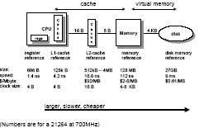
Memory hierarchy

Slide 24
System Bus
R1
R2
Incrementer
A
B
ALU
Complementer
C
D
Shifter
Flag Register
Working
Reg

Slide 25
A Simplified Control Unit
Control Unit
Fetch
Fetch Unit
Decode
Decode Unit
Execute
Execution Unit
Write Back
Write Back Unit

Slide 26
Internal organization of CU
Memory
Program counter(PC/IAC)
M
A
R
Opcode operand 1 operand2
MDR
Opcode Decoder
Pulse distributer
Clk
generator
Pulse sequencer

Slide 27
Generations of Computers

Slide 28
First Generation (1945-54)
Single CPU
Accumulator based.
Fixed point Execution
All the operations.
PC
ALP and MLP
Ex: ENIAC,Princeton IAS ,IBM 701

Slide 29
II Generation(1955-64)
Index Register
Fixed point and Floating point.
Multiplexed Memory
Batch Processing
Subroutine and Libraries.
IOP
RTL

Slide 30
II Generation (Contd..)
HLL such as FORTRAN,COBOL,ALGOL
EX: IBM7090, UNIVAC LARC

Slide 31
III Generation (1965-74)
Pipelining
Cache memory
Virtual Memory
Multiprogramming
Time sharing
Ex: IBM 360/370, CDC 6600/7600,TI ASC
DE PDP8

Slide 32
IV Generation (1975-90)
Parallel Computers
Shared Memory and Distributed Memory.
Multiprocessing O.S (MACH)
Ex:IBM3090,BBN TC 2000, VAX 9000
CRAY X-MP

Slide 33
V-Generation
MPP
Scalable
Latency Tolerant
Terra flops
Heterogeneous Processing.
Ex: KABRU,FUJITSU,PARAGON

Slide 34
Addressing Modes

Slide 35
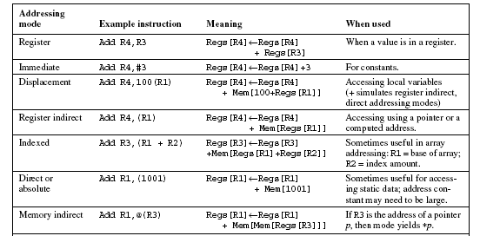
Addressing modes

Slide 36
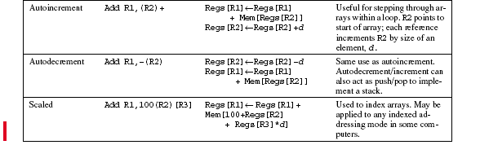

Slide 37
Instruction formats at a glance
Four address format
Three address format
Two address format
Single address format
Zero address format

Slide 38
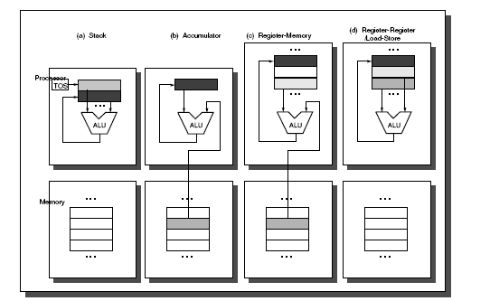
Instruction Set Architectures

Slide 39
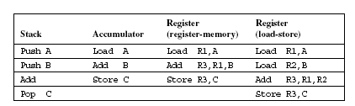
Examples

Slide 40
Instruction Types
A computer must have instructions capable of performing three types of operations.
Data transfers instructions: Transfers information data from one location to another with out changing the binary information contents

Slide 41
Name Mnemonic Meaning
Load LD Transfers data from memory to processor
register
Store ST Transfers data from processor register to
Memory
Move MOV Transfers data from one register to another
Register it has also been used to transfer data between cpu reg and memory (or) between
Two memory locations.
Exchange XCH Used to swap the data between two registers
(or) between reg and memory vice versa.
Input IN Data transfers between the processor regis
Output OUT and input or output terminal.
PUSH PUSH Transfers data between processor register and
POP POP memory stack

Slide 42
Data Manipulation Instructions: These are the instructions that perform arithmetic, logical and shift operations.

Slide 43
Arithmetic operations:
Name Mnemonic Meaning
Increment INC Increment the contents of a register
Decrement DEC Decrement the contents of a register
ADD ADD Add the contents of two registers (or)
Contents of a register and memory.
Subtraction SUB Subtract the contents of two registers (or)
Contents of a register and memory.
Multiply MUL Multiply the contents of two registers (or)
Contents of a register and memory.
Divide Div Divide the contents of two registers (or)
Contents of a register and memory.
Add with ADDC Add the contents of two registers with carry
carry (or)Contents of a reg and memory with carry
Subtract with SUBB Sub the contents of two registers with borrow
carry (or)Contents of a reg and memory with borrow
borrow.
Negate NEG Perform 2’ complementation on the given
number

Slide 44
Logical Operations
Name Mnemonic Meaning
Clear CLR Clear the contents of a register or Memory
location
Complement COM Complement the contents of a register.
AND AND Perform logical AND operation
OR OR Perform logical OR operation
Exclusive OR XOR Perform logical XOR operation
Clear carry CLRC Clear the carry flag
Set carry SETC Set the carry flag.
Complement COMC Complement the carry flag
Carry
Enable EI Set the interrupt flag
Interrupt
Disable DI Disable interrupt flag
Interrupt

Slide 45
Shift operations
Name Mnemonics
Logical Shift Right SHR
Logical Shift Left SHL
Arithmetic Shift Left SHLA
Arithmetic Shift Right SHRA
Rotate Right ROR
Rotate Left ROL
Rotate Right Thru Carry RORC
Rotate Left Thru Carry ROLC

Slide 46
Program Control Instructions
Name Mnemonics
Branch BR
Jump JMP
Skip SKP
Call CALL
Return RET
Compare (By Subtraction) CMP
Test (By AND ing) TST

Slide 47
Memory Operand Addressing
Big End
Little End

Slide 48
Memory Operand Addressing…
B31-b24
b23-b16
b15-b8
b7-b0
Big Endian
0
1
2
3
3
2
1
0
Little Endian

Slide 49
Little Endian Big Endian
0
b7-b0
b31-b24
0
1
b15-b8
b23-b16
1
2
b23-b16
2
b15-b8
3
b31-b24
3
b7-b0
Ex: Intel series
Ex: Motorola series

Slide 50
Buses
All the Functional units must be connected
Different type of connection for different type of unit
  Memory
  Input/Output
  CPU

Slide 51
Memory Connection
Receives and sends data
Receives addresses (of locations)
Receives control signals
  Read
  Write
  Timing

Slide 52
Input/Output Connection(1)
Similar to memory from computer’s viewpoint
Output
  Receive data from computer
  Send data to peripheral
Input
  Receive data from peripheral
  Send data to computer

Slide 53
Input/Output Connection(2)
Receive control signals from computer
Send control signals to peripherals
  e.g. spin disk
Receive addresses from computer
  e.g. port number to identify peripheral
Send interrupt signals (control)

Slide 54
CPU Connection
Reads instruction and data
Writes out data (after processing)
Sends control signals to other units
Receives (& acts on) interrupts

Slide 55
Performance
Measure, Report, and Summarize
Make intelligent choices
See through the marketing hype
Key to understanding underlying organizational motivation

Slide 56
Computer Performance: TIME, TIME, TIME
Response Time (latency)
— How long does it take for my job to run?
— How long does it take to execute a job?
— How long must I wait for the database query?
Throughput
— How many jobs can the machine run at once?
— What is the average execution rate?
— How much work is getting done?
Notes:
Have them raise their hands when
answering questions

Slide 57
Execution Time
Elapsed Time
  counts everything (disk and memory accesses, I/O , etc.)
  a useful number, but often not good for comparison purposes
CPU time
  doesn't count I/O or time spent running other programs
  can be broken up into system time, and user time
Our focus: user CPU time
  time spent executing the lines of code that are "in" our program

Slide 58
Book's Definition of Performance
For some program running on machine X,
Performance_{X} = 1 / Execution time_{X}
"X is n times faster than Y"
Performance_{X}
Performance_{Y} = n
Problem:
  machine A runs a program in 20 seconds
  machine B runs the same program in 25 seconds

Slide 59
Performance …
Execution time = no. of clock cycles * cycle time
Execution time = no. of clock cycles
Clock rate

Slide 60
But
no of clock cycles = Instruction count * Average Cycles per Instruction
Execution time = I.C * CPI * Cycle time
= I.C * CPI
clock rate

Slide 61
Performance …
MOV AX,90 → 2 Cycles
MOV BX,50 → 2 Cycles
ADD AX,BX → 1 Cycle
STA AX,4500 → 3 Cycles
HLT → 1 Cycle
CPI = 9 /5 =1.8

Slide 62
Clock Cycles
Instead of reporting execution time in seconds, we often use cycles
Execution time = I.C * CPI * Cycle time
Seconds = instruction * cycles * seconds
Program Program instruction cycles
I.C => Instrn count (Dynamic Vs Static)
- Dynamic I.C useful in performance (timing)
- Static I.C useful in code size.

Slide 63
Performance …
Execution Time = I.C * CPI * Cycle Time
- I.C → depends on ISA and Compiler tech
- CPI → depends on ISA and organization
- C.T → depends on organization and technology

Slide 64
Performance …
CPI – Avg Cycles Per Instruction(CPI) computed from the instruction mix.
ALU L/S Cond Uncond
Jmp Jmp
Freq 40 25 20 15
cycles 4 5 3 2
CPI

Slide 65
Performance …
CPI =40% * 4+ 25% *5 + 20%*3 + 15%*2
= 0.4*4+0.25 * 5+ 0.5*3 + 0.15*2
=3.75

Slide 66
Amdahl's Law
Execution Time After Improvement =
Execution Time Unaffected +Execution Time Affected Amount of Improvement

Slide 67
Amdahl's Law
Speedup due to enhancement E:
ExTime w/o E Performance w/ E
Speedup(E) = ------------- = -------------------
ExTime w/ E Performance w/o E
Suppose that enhancement E accelerates a fraction F of the task by a factor S, and the remainder of the task is unaffected

Slide 68
Amdahl’s Law
ExTime_{new} = ExTime_{old} x (1 - Fraction_{enhanced}) + Fraction_{enhanced}
Speedup_{enhanced}
1
ExTime_{old}
ExTime_{new}
Speedup_{overall} =
=
(1 - Fraction_{enhanced}) + Fraction_{enhanced}
Speedup_{enhanced}

Slide 69
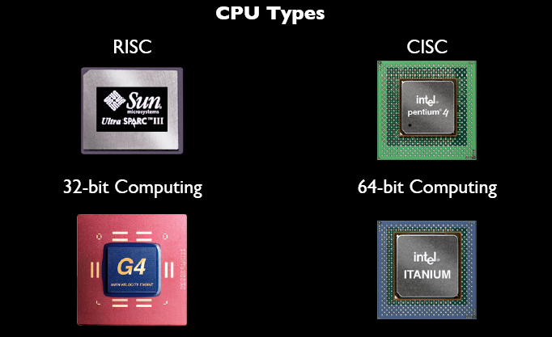
RISC Vs CISC

Slide 70
RISC | CISC
Reduced Instruction Set Computer | Complex Instruction set computer
Less number of instructions (64-100) | More number of instructions. (100-250)
Fixed length instruction formats (32 bits) | Variable length instruction formats (32 bits)
Limited addressing modes (3-5) | More addressing modes (12-24)

Slide 71
RISC | CISC
More no. of general purpose registers (32-192) | Limited no. of general purpose registers ( 8-20)
It employs H/w control organization. | It employs micro-program control organization. Recent architectures Employ h/w tech
It does not uses control memory | It uses control memory
Memory manipulation instructions are available | No memory manipulation instructions are available. Memory access is limited to simple LOAD/STORE instructions

Slide 72
RISC | CISC
Split caches were used | Unified cache was used. Now a days split caches were used
Clock speed (50-150Mhz in 1992) | Clock speed (33-50Mhz in 1992)
SPARC,DLX,MIPS architectures | Intel 80x86,Motorola MC68000 series

Slide 73
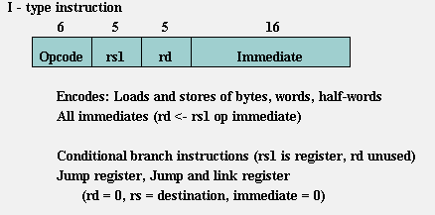
Instruction Types of MIPS

Slide 74
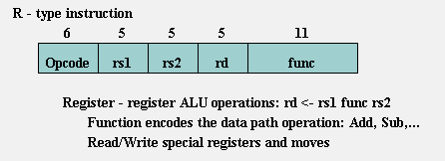
Instruction Types of MIPS (Cont..)

Slide 75
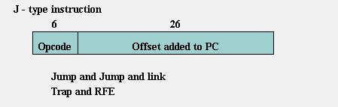
Instruction Types of MIPS (Cont..)

Slide 76
5-segment MIPS pipeline
Instruction fetch cycle (IF)
Instruction decode/register fetch (ID)
Execution/Effective address cycle (EX)
Memory access/branch completion (MEM)
Write-back cycle (WB)

Slide 77
Pipeline char diag
Instr Num | 1 | 2 | 3 | 4 | 5 | 6 | 7 | 8 | 9
instr i | IF | ID | EX | MEM | WB
instr i+1 |  | IF | ID | EX | MEM | WB
instr i+2 |  |  | IF | ID | EX | MEM | WB
instr i+3 |  |  |  | IF | ID | EX | MEM | WB
instr i+4 |  |  |  |  | IF | ID | EX | MEM | WB

Slide 78
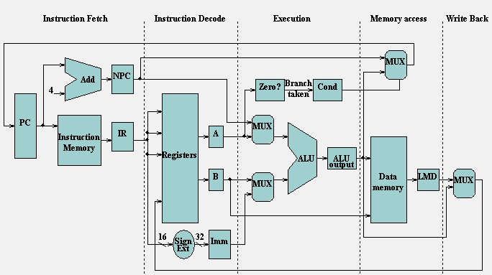
MIPS Pipeline processor

Slide 79
Instruction Fetch Cycle
IR <- MEM[PC]
NPC <- PC +4

Slide 80
Instruction decode/register fetch (ID)
    A <- Regs[IR6..10]
    B <- Regs[IR11..15]
    Imm <- ((IR16)16##IR16..31)

Slide 81
Execution/Effective address cycle (EX)
Memory reference:
  ALUOutput <- A +Imm
Register-Register ALU instruction:
  ALUOutput <- A op B
Register- Immediate ALU instruction:
  ALUOutput <- A op Imm
Branch:
  ALUOutput <- NPC + Imm
  Cond <- ( A op 0 )

Slide 82
Memory access/branch completion cycle (MEM)
Memory reference:
LMD <- Mem[ALUOutput] or Mem[ALUOutput] <- B
Branch:
if (cond) PC <- ALUOutput
else PC <- NPC

Slide 83
Write-back cycle (WB)
Register-Register ALU instruction: Regs[IR16..20] <- ALUOutput Register
Immediate ALU instruction:
Regs[IR11..15] <- ALUOutput
Load instruction:
Regs[IR11..15] <- LMD

Slide 84
Questions
A memory unit with a capacity of 65,536 words of 25 bits each. It is used in conjunction with a general-purpose computer. The instruction code is divided into four parts an indirect mode bit, opcode, two bits that specify a processor register and an address part.
what is the maximum number of operation that can be in the computer if the instruction is stored in one memory word.
Draw the instruction word format indicating the number of bits and the function of each part.
How many processor registers are there in the computer and how many bits in each. How many bits are there in MBR,MAR and PC

Slide 85
Questions
what is the difference between a direct and indirect addressed instruction? How many reference are needed for each type of instruction if the instruction is in memory and to bring an operand in to a processor register.

Slide 86
Thank you

